Slide 1
Curriculum 1
Mike Gennert, Worcester Polytechnic Institute
5 January 2022

Slide 2
Talk Roadmap
Background
Mechatronics & Robotics Education
Engineering a Major
Outcome

Slide 3

About WPI
Private, founded in 1865
Focus on
Engineering
Science
Management
Granting
BS, BA
MS, MEng
PhD
60+ disciplines
Notes:
WPI is the 3rd oldest engineering school in the US
Although WPI has historically been known as an undergraduate university, we also have graduate programs. Ever since ‘89.
1889!

Slide 4
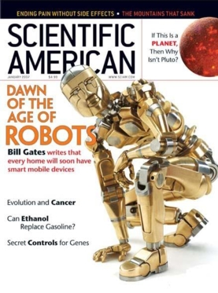
A Robot in Every Home
Scientific American, January 2007
“I can envision a future in which robotic devices will become a nearly ubiquitous part of our day-to-day lives… to see, hear, touch and manipulate objects in places where we are not physically present.”
— Bill Gates, Microsoft Chairman
Notes:
In 2007, just as we were thinking about a robotics major, Scientific American published an article on “A Robot in Every home”,
Predicting that robots would become ubiquitous, just as the Personal Computer had.
The author knew a thing or two about PCs.

Slide 5
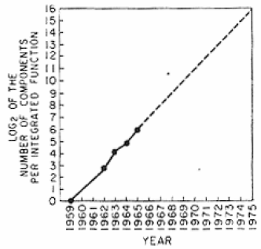
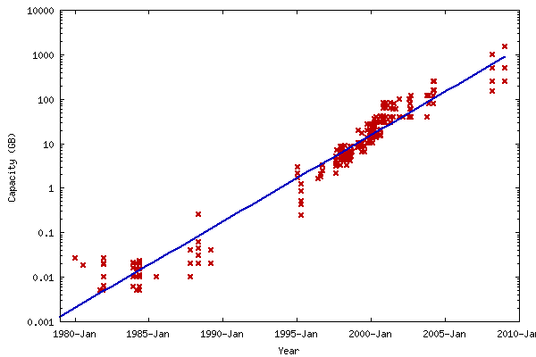
Driving Factors
Double at regular intervals
Moore’s Law
Processors @ 1.5-2 years
Kryder’s Law
Storage @ 1.5 years
Butter’s Law – Network @ 9 months
Notes:
Unfortunately, our Mechanical Engineering colleagues haven't been able to improve motor performance at similar rates.

Slide 6
The Robotics Equation
Sensors,
Computing devices,
Actuators,
Communications
COST
Defense & Security,
Medicine & Elder care,
Consumer,
Manufacturing,
Logistics,
Entertainment
NEED
}
Tasks that are too
Dull
Dangerous The 3 Ds
Dirty
for humans
Notes:
speaks for itself

Slide 7
Talk Roadmap
Background
Mechatronics & Robotics Education
Engineering a Major
Outcome

Slide 8



Robotics Education
+
+
Notes:
Robotics Ed = ECE + CS + ME
Can’t fit 3 4-year degrees into a 4-year degree.
Will talk about what we did later

Slide 9
Undergraduate Mechatronics & Robotics
Associates
Mostly tech, maintenance, factory
Bachelors
Many courses
Minors
Concentrations, focus areas, threads …
Notes:
Many community colleges teach automation
Many universities & colleges have a course or 2 on robotics or even a cluster of courses…
And mechatronics, which is what brings many of us together.

Slide 10
Robotics Education Gap
“Making useful robots,
Making robots useful”
Robotics Research
PhD @
Large Research
University
Mechatronics &
Robotics
Engineering
Industrial Robotics
Technology
AA, AS @
Community College
“Don’t know what robots will do in 10 or 30 years.
But we can educate the engineers to make them.”
Notes:
There is this gap between technician-level (robot technology) programs …
… and research-level (robot science) programs that is many years or decades from commercialization
To fill that gap, we created a BS degree in Robotics Engineering – educating engineers to design and develop robotic devices. Also MS and PhD

Slide 11

How Hard Can It Be?
Creating a new program is a lot of work
Why bother?
http://coconutheadsets.com/wp-content/uploads/2009/12/sisyphus.jpg
Notes:
Actually, it was harder for us than it would be for you, because we had no model or template to follow. You do.

Slide 12
The Education Business
Understand the business you are in
“But we’re non-profit.”
“Yeah, right.”
Must have revenue ≥ expense
Invest: $ / energy / time / people / space
Return: $ / tuition / funding / prestige / …
New program is an Academic / Social / Business Decision
Notes:
My sister is a professor. I asked her what business she is in. She looked at me like I had 3 heads. Like most faculty, she had never connected university and business.
You’re asking the university to invest …
In order to generate …

Slide 13
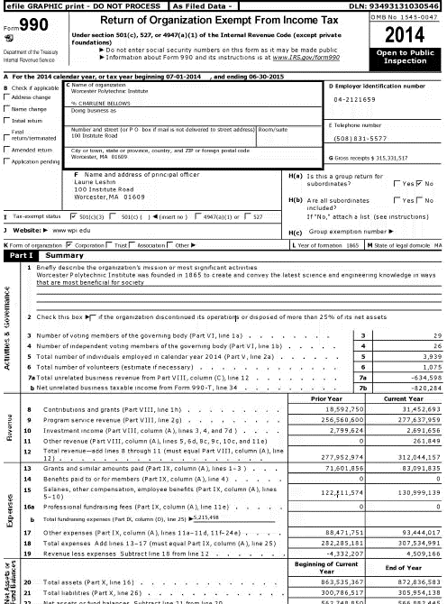
Notes:
Here is IRS Form 990, which every non-profit must file. Assets, liabilities, revenues, expenses, officers, …

Slide 14
Talk Roadmap
Background
Mechatronics & Robotics Education
Engineering a Major
Outcome

Slide 15
Engineering a Major Top-Down
Iterate
Iterate
Vision
Stakeholders
Mission
Goals
Objectives
Outcomes
Principles
Curriculum
Courses
Labs
Assessments
Resources
Iterate
Iterate
Notes:
It’s almost funny how engineering faculty don’t often apply the design process to what they do the most of.

Slide 16
Our Vision
Exemplary, nationally recognized,
Multidisciplinary center for
Education, research, and innovation in
Robotics
Notes:
We started with a vision

Slide 17
Key Ideas
Multidisciplinary: CS / ECE / ME
Spiral Curriculum:
Intro to Robotics
Unified Robotics I-IV
Actuation, Sensing, Manipulation, Navigation
Social Implications
Entrepreneurship & the enterprising eng’r
Project-based
New-fangled & old-fashioned engineering
It’s never “Not my job!”
Notes:
Did I mention that it was multi-disciplinary?!
5 course sequence: Intro and Unified 1-4. Similar to MIT’s Aero & Astro Unified Engineering 1-4. Each course has a focus that spans CS / ECE/ ME [Can talk about one, for example]
We seriously believe in educating engineers with an entrepreneurial mindset. Even if they aren’t starting companies, they need to know about the business they are in, what “value proposition” means, etc.

Slide 18
Principles
Broadly-based with targets in each discipline
ECE: Embedded Computing
CS: Programming, Software Eng
ME: Statics, Controls
Flexible
Electives: Many
Paths: Multiple
Notes:
Go through this fast

Slide 19
Principles, continued
4 years
Fits better in 5, but…
Consistent w/ WPI Philosophy
“Lehr und Kunst” — Theory and practice
Project-based learning
Accreditable
Adds credibility for students, faculty
ROTC, FE Exam
Notes:
Faster!
One of our ABET evaluators said we had a problem, “Our students and faculty are way too enthusiastic!”

Slide 20
Curriculum 1.0
X
Black: Required General Education (11 courses)
Green: Required Basic Math and Science (10 courses)
Red: Required Engineering (18 courses)
Blue: Recommended Engineering and Free Electives (9 courses)
Class | A Term | B Term | C Term | D Term
Freshman | Calculus 1 Physics 1 HU&A | Calculus 2 Science HU&A | Calculus 3 Science HU&A | Calculus 4 Physics 2 HU&A
Sophomore | CS 1 Intro to Robotics HU&A | CS 2 Linear Algebra HU&A | CS 3 ECE 1 Social Science | Differential Eqs ECE 2 Social Science
Junior | ECE 3 Statics Junior Project | Dynamics Algorithms Junior Project | Machine Design Project Preparation Junior Project | ECE 4 Software Eng Robotics Elective 1
Senior | AI Controls Capstone Project | Robotics Elective 2 Free Elective Capstone Project | Robotics Elective 3 Free Elective Capstone Project | Free Elective Free Elective Free Elective
Intro to Robotics
Where’s the Robotics?
Notes:
Our 1st attempt at curriculum. We asked, “What do we need to teach robotics?” Oh, we have that. And look, it all fits, right off the self. Or out of the Catalog. But there’s a problem…
Where’s the robotics? Oh, there it is. Not real good.
So we threw this away and started over.

Slide 21
Breakthrough Concept
Can’t just add Robotics courses
Rip out middle engineering courses
CS: Data Structures, Algorithms, …
ECE: Signals, Microelectronic Circuits, …
ME: Dynamics, Machine Design, …
Slice curriculum horizontally, not vertically
Each course includes CS, ECE, ME concepts → No silos
Organize around Actuation, Sensing, Manipulation, Navigation
Unified Robotics 1-4
Disclaimer: Cannot cover exact same material, so …
Don’t even try!

Slide 22

Spiral Curriculum
Navigation
Manipulation
Sensing
Actuation
Intro to Robotics
Notes:
File:F5 tornado Elie Manitoba 2007.jpg use permitted under Wikimedia Commons
Intro to Robotics sucks them in and then they’re trapped in the spiral curriculum!

Slide 23
Curriculum Outline
Other Courses
DiffEqs, LinAlg,
Prob, Controls,
Embedded, …
Intro Courses
CS, ECE, ME
Unified Robotics 1-4
Actuation, Sensing, Manipulat’n, Navigat’n
Advanced Courses
Capstone Project
Notes:
We decided to rip out the middle of the curriculum and teach the same material – more or less – in the context of robotics.
We don’t want to teach intro to everything all over again, so we let the experts in CS, ECE, and ME do that.
Then we have the Unified Robotics sequence, folding in other courses as needed: Diff Eqs, Lin Alg, Probability, Controls, Embedded Systems. Just-in-time education
And of course, advanced course electives and a capstone project. By this time, the students have had so many in-class projects that they are totally project-ready

Slide 24
Core Robotics Curriculum
Year 1
Mechanics
Introduction to Robotics
E&M, Statics, Digital Systems
Unified Robotics 1: Actuation
Year 2
Program Design
Unified Robotics 2: Sensing
Embedded, OO Prog, Diff. Eq., Lin. Alg.
Unified Robotics 3: Manipulation
Year 3
Controls, Probability
Unified Robotics 4: Navigation
Year 4
Advanced Electives
Capstone Project

Slide 25
Curriculum 2.0
!
Where’s the Robotics?
Black: Required General Education (12 courses)
Green: Required Basic Math and Science (11 courses)
Red: Required Engineering (13 courses)
Blue: Recommended Engineering and Free Electives (9 courses)
Notes:
So this is how it looks now. This is just a sample, there are 1000s of ways to do it.

Slide 26
Robotics Engineering Allocation
WPI Reqs
Gen Ed
RBE
ABET Reqs
Notes:
Here’s how the curriculum breaks down. Poor choice of words…

Slide 27
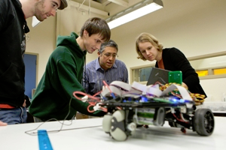
Courses
Undergraduate
Graduate
RBE1001 Intro to Robotics
RBE2001 Unified 1: Actuation
RBE2002 Unified 2: Sensing
RBE3001 Unified 3: Manipulation
RBE3002 Unified 4: Navigation
RBE3100 Social Implications of Robotics
RBE4322 Mechatronics
RBE450X Vision-based Robotic Manipulation
RBE4815 Industrial Automation
RBE500 Foundations
RBE501 Dynamics
RBE502 Robotic Control
RBE510 Multi-Robot Sys
RBE520 Biomechanics & Robotics
RBE521 Legged Robotics
RBE526 Human-Robot Interaction
RBE530 Soft Robotics
RBE533 Smart Materials & Actuation
RBE549 Computer Vision
RBE550 Motion Planning
RBE580 Biomedical Robotics
RBE594 Capstone Proj Experience
RBE595 Special Topics
Notes:
We don’t have a lot of upper-level undergraduate electives. Students can take upper-level courses in other departments or take graduate robotics courses.

Slide 28
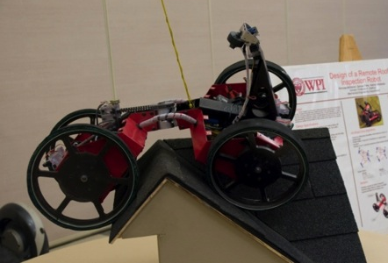
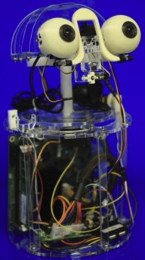
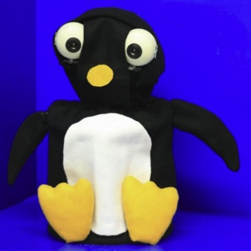
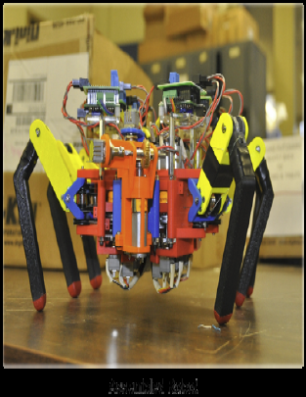
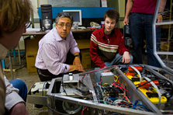
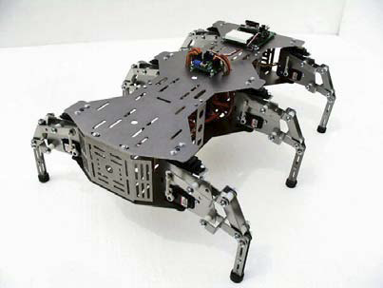
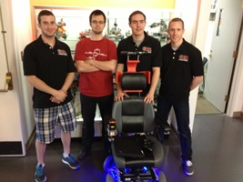
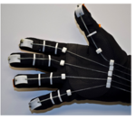
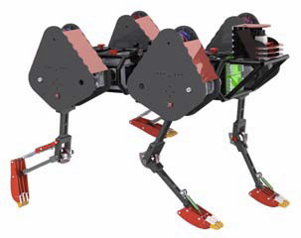
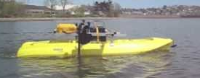
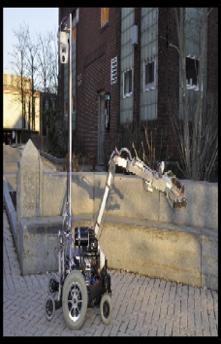
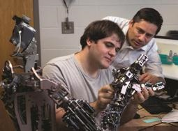
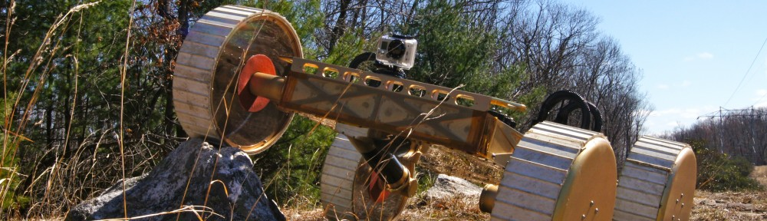
Capstone Projects
Notes:
A sample of our capstone projects

Slide 29
But …
Not everything fit
Do not require
Algorithms
Artificial Intelligence
Signals
Mechanical Design
4 years of really good stuff!
}
Available as electives
Notes:
Although we don’t require these courses, they are available as electives. Our students are adults and they make decisions on their education. With our advice. Sometimes, against our advice.

Slide 30
Talk Roadmap
Background
Mechatronics & Robotics Education
Engineering a Major
Outcome

Slide 31
Enrollment
Business Plan: 15-25 students
Day 1: 80 students
Today: ~700 students
3rd largest enrollment
17 FT faculty
Newest department
Notes:
We’ve had steady enrollment growth
When we launched the program, our business plan – we actually wrote a business plan – showed that we’d be profitable, if an academic can use the word profit, with 15-20 students / year, growing to 25-30 students / year.
On day 1, 80 kids showed up! And they’re still coming.

Slide 32
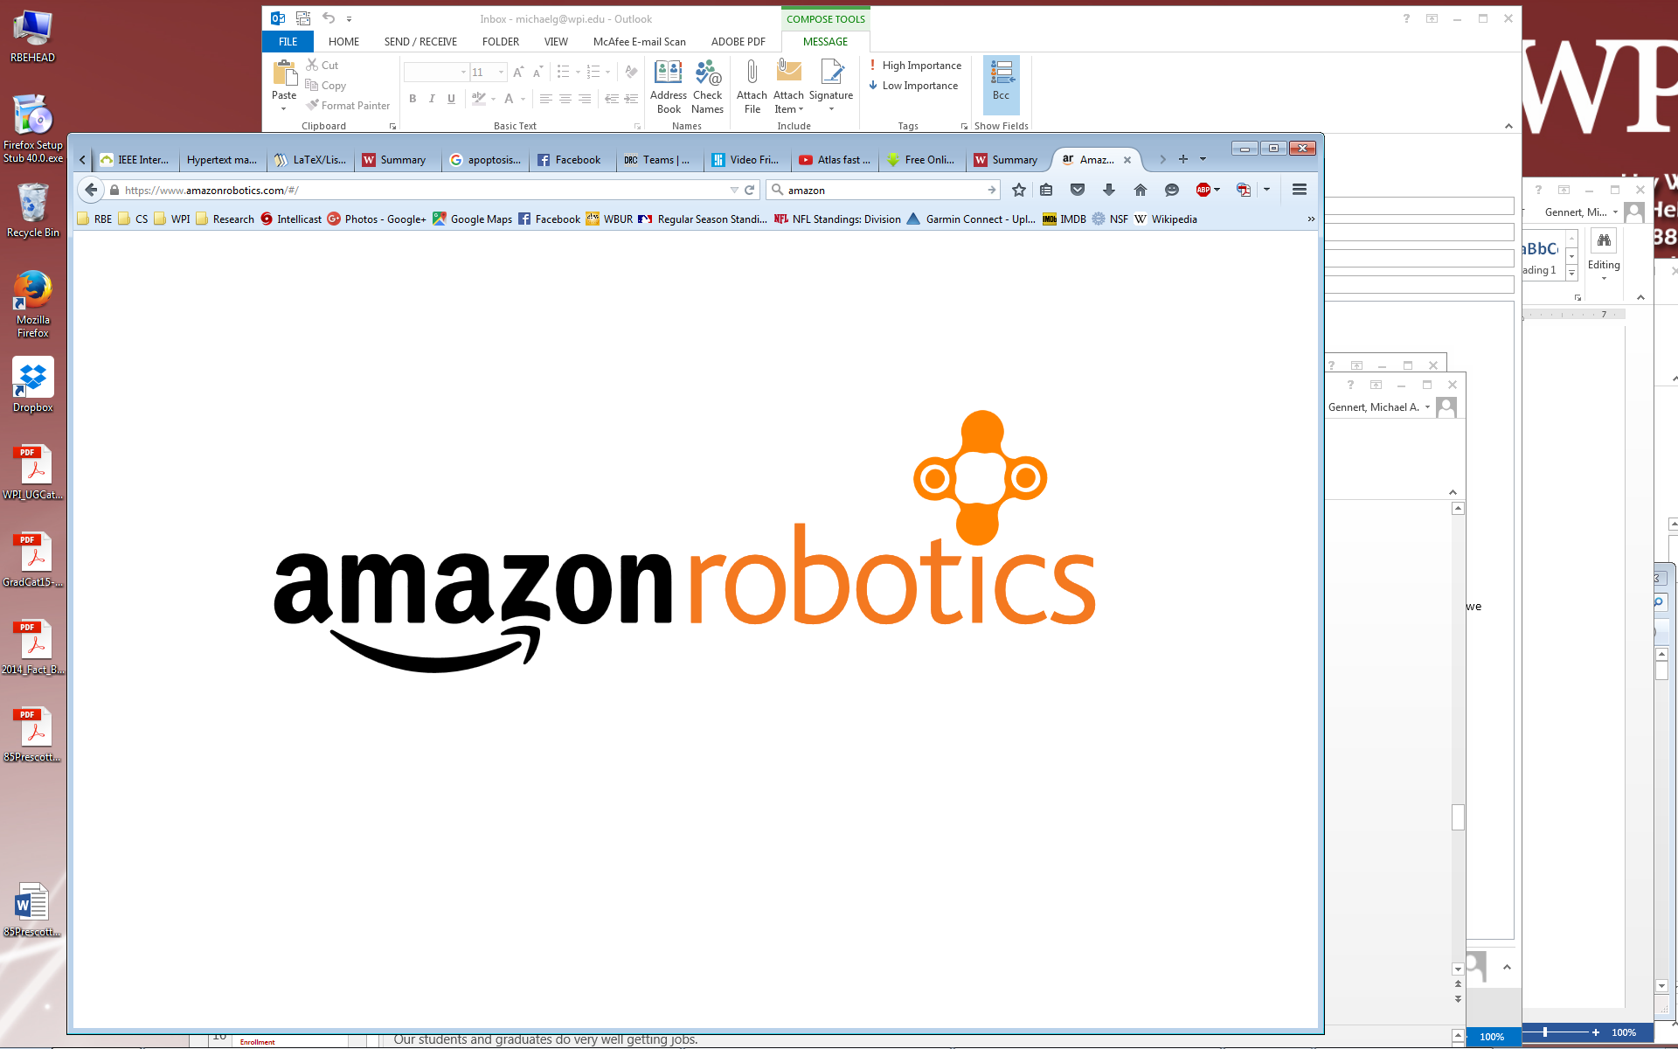






























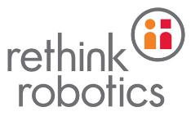









Jobs & Internships
Notes:
Our students and graduates do very well getting jobs.
They complain to us about how much work they do.
And they brag about it to recruiters.
Some of these companies are clearly in robotics: iRobot, Bluefin Robotics, Black-I robotics, Boston Dynamics, …
Others are more general engineering firms that want to hire great talent: BAE, General dynamics, Bose, Raytheon, MITRE.

Slide 33
Lessons Learned
For faculty buy-in
Robotics is a highly viable major
Need vision & passion… & a business plan
Bottom-up approach better than top-down
Top-down approach better than bottom-up
Well-designed curriculum evolves
Stick to your principles
Be open to compromise on anything else
Communicate & cooperate
Students – and faculty – will work hard
Be bold & Have fun!
For curriculum design
Notes:
We learned a lot. I could go on and on and on …

